Slide 1
1 | 2 | 3 | 4 | 5 | 6
7 | 8 | 9 | 10 | 11 | 12
13 | 14 | 15 | 16 | 17 | 18
19 | 20 | 21 | 22 | 23 | 24
25 | 26 | 27 | 28 | 29 | 30
31 | 32 | 33 | 34 | 35 | 36
Si x(1,1)=1 entonces ninguna figura adicional se puede asignar a x(7),x(8),x(9)
X(1) <= x(2) + x(7)
X(2) + x(7) <= 1
X(8) <= x(1)
X(9) – x(8) – x(2) >= -1
1 | 2 | 3 | 4 | 5 | 6
7 | 8 | 9 | 10 | 11 | 12
13 | 14 | 15 | 16 | 17 | 18
19 | 20 | 21 | 22 | 23 | 24
25 | 26 | 27 | 28 | 29 | 30
31 | 32 | 33 | 34 | 35 | 36
1 | 2 | 3 | 4 | 5 | 6
7 | 8 | 9 | 10 | 11 | 12
13 | 14 | 15 | 16 | 17 | 18
19 | 20 | 21 | 22 | 23 | 24
25 | 26 | 27 | 28 | 29 | 30
31 | 32 | 33 | 34 | 35 | 36

Slide 2
1 | 2 | 3 | 4 | 5 | 6
7 | 8 | 9 | 10 | 11 | 12
13 | 14 | 15 | 16 | 17 | 18
19 | 20 | 21 | 22 | 23 | 24
25 | 26 | 27 | 28 | 29 | 30
31 | 32 | 33 | 34 | 35 | 36
X(1) <= x(2) + x(7)
X(2) + x(7) <= 1
X(8) <= x(1)
X(9) – x(8) – x(2) >= -1
1 | 2 | 3 | 4 | 5 | 6
7 | 8 | 9 | 10 | 11 | 12
13 | 14 | 15 | 16 | 17 | 18
19 | 20 | 21 | 22 | 23 | 24
25 | 26 | 27 | 28 | 29 | 30
31 | 32 | 33 | 34 | 35 | 36
1 | 2 | 3 | 4 | 5 | 6
7 | 8 | 9 | 10 | 11 | 12
13 | 14 | 15 | 16 | 17 | 18
19 | 20 | 21 | 22 | 23 | 24
25 | 26 | 27 | 28 | 29 | 30
31 | 32 | 33 | 34 | 35 | 36

Slide 3
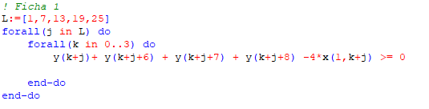
1 | 2 | 3 | 4 | 5 | 6
7 | 8 | 9 | 10 | 11 | 12
13 | 14 | 15 | 16 | 17 | 18
19 | 20 | 21 | 22 | 23 | 24
25 | 26 | 27 | 28 | 29 | 30
31 | 32 | 33 | 34 | 35 | 36
J = 1
K = 0
Y(1) + Y(7) + Y(8) + Y(9) – 4*X(1,1) >= 0
d(1) +d(7)+d(8)+d(9) - 4*x(1,1)*p(1) = 0
x(1,1)* [d(1) +d(7)+d(8)+d(9) - 4*x(1,1)*p(1)] = x(1,1)*
1 | 2 | 3 | 4 | 5 | 6
7 | 8 | 9 | 10 | 11 | 12
13 | 14 | 15 | 16 | 17 | 18
19 | 20 | 21 | 22 | 23 | 24
25 | 26 | 27 | 28 | 29 | 30
31 | 32 | 33 | 34 | 35 | 36
1 | 2 | 3 | 4 | 5 | 6
7 | 8 | 9 | 10 | 11 | 12
13 | 14 | 15 | 16 | 17 | 18
19 | 20 | 21 | 22 | 23 | 24
25 | 26 | 27 | 28 | 29 | 30
31 | 32 | 33 | 34 | 35 | 36

Slide 4
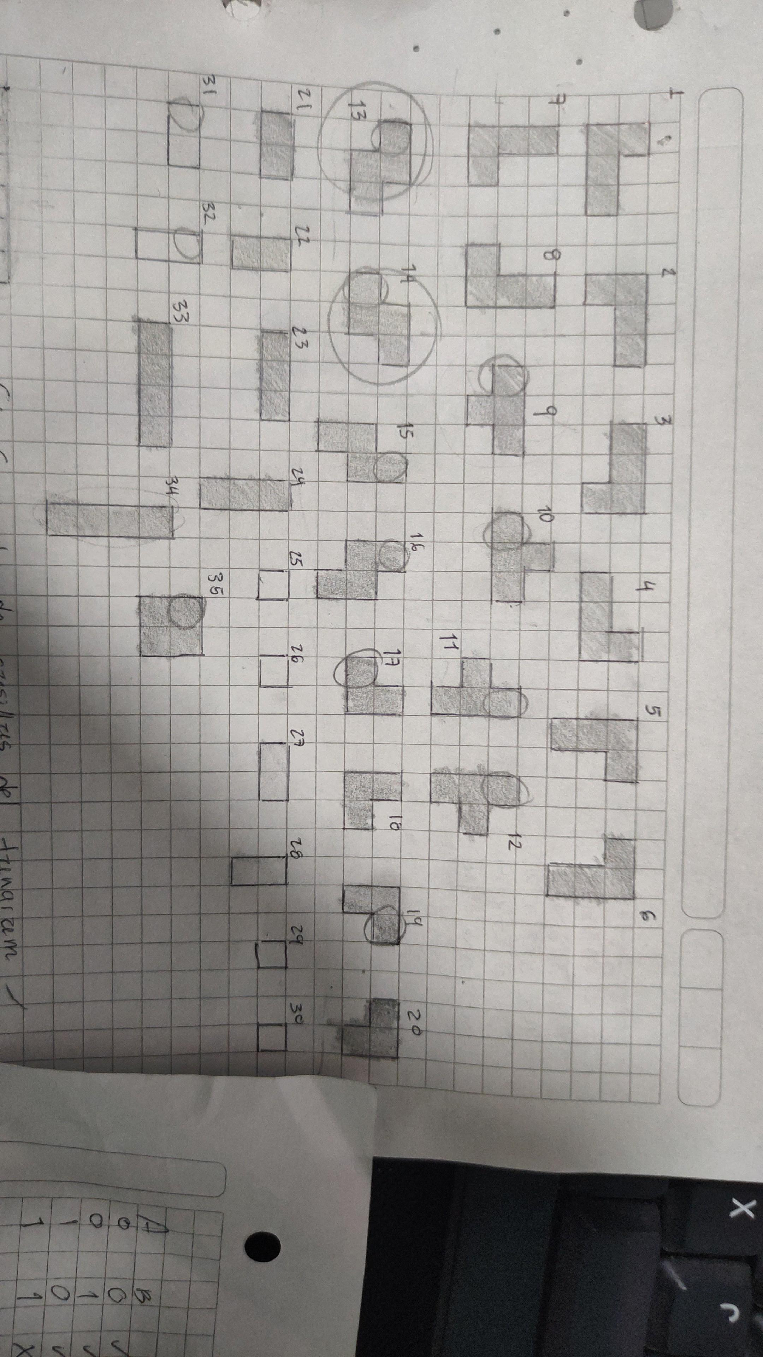
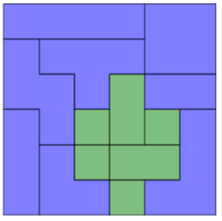
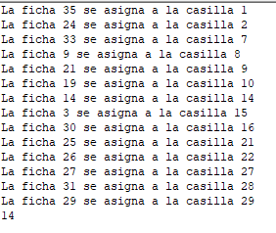
X(i,j): coloco o no la ficha i en la casilla j.
Y(j): la casilla j esta ocupada.
d(j): color deseado para la casilla j. 1 si azul, 2 si verde.
p(i): color de la figura i.
Hacer una restricción de igualdad cuando se asigna y que se elimine cuando no se asigna.
D(15)=p(20)*x(20,15)
d(15)+d(16)+d(22) <= P(20)*x(20,15)
(1-x(20,15))
1 | 2 | 3 | 4 | 5 | 6
7 | 8 | 9 | 10 | 11 | 12
13 | 14 | 15 | 16 | 17 | 18
19 | 20 | 21 | 22 | 23 | 24
25 | 26 | 27 | 28 | 29 | 30
31 | 32 | 33 | 34 | 35 | 36
1 | 2 | 3 | 4 | 5 | 6
7 | 8 | 9 | 10 | 11 | 12
13 | 14 | 15 | 16 | 17 | 18
19 | 20 | 21 | 22 | 23 | 24
25 | 26 | 27 | 28 | 29 | 30
31 | 32 | 33 | 34 | 35 | 36

Slide 5
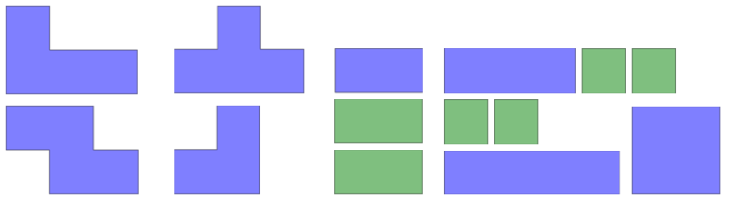

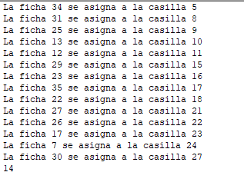
d(33)+d(34)+d(28) +d(29) -4*x(14,33)*p(20) = 0
1+(2x3)=7 - 4
1 | 2 | 3 | 4 | 5 | 6
7 | 8 | 9 | 10 | 11 | 12
13 | 14 | 15 | 16 | 17 | 18
19 | 20 | 21 | 22 | 23 | 24
25 | 26 | 27 | 28 | 29 | 30
31 | 32 | 33 | 34 | 35 | 36
1 | 2 | 3 | 4 | 5 | 6
7 | 8 | 9 | 10 | 11 | 12
13 | 14 | 15 | 16 | 17 | 18
19 | 20 | 21 | 22 | 23 | 24
25 | 26 | 27 | 28 | 29 | 30
31 | 32 | 33 | 34 | 35 | 36

